Slide 1
Compilers 101
Autovectorization

Slide 2
Previously…
Preprocessing
Lexical analysis
Frontend
Syntax analysis
Semantic analysis
IR Generation
IR Optimization
Middle-end
Code generation
Backend
Optimization

Slide 3
Today
SIMD
SIMT
Vectorization

Slide 4
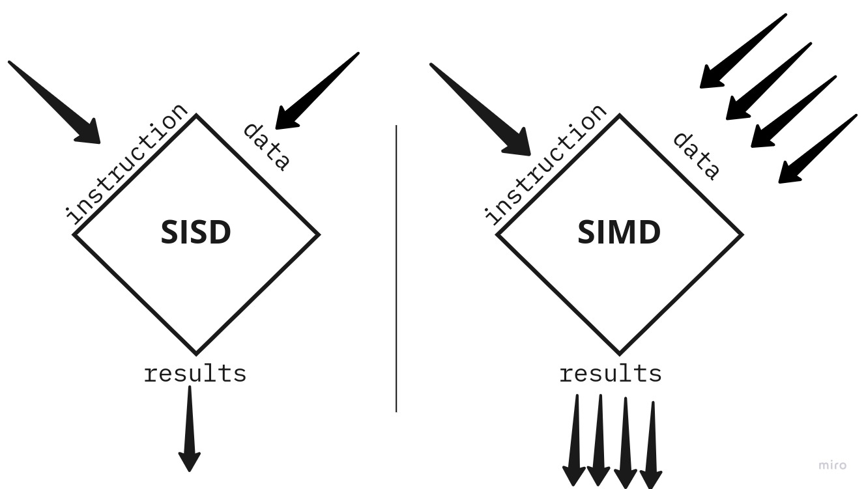
Single Instruction Multiple Data
1 | 2 | 3 | 4
5 | 6 | 7 | 8
6 | 8 | 10 | 12
https://ishuah.com/2021/12/19/a-benchmark-study-simd-intrinsics/

Slide 5
Motivation
CPU speed reaches plateau
Power limitations
Chip architects get more transistor budget
Doing many operations in parallel is much simpler, than doing operations faster
Two solutions: many cores and many EUs
Many applications don’t require independent threads (think of linear algebra)

Slide 6
History
Year | Register Length (bits) | Instruction Set | Architecture
1999 | 128 | SSE | x86
1999 | 128 | Altivec | PowerPC
2010 | 128 | VSX | POWER
2011 | 128 | NEON | ARM
2011 | 256 | AVX | x86
2013 | 256 | AVX2 | x86
2016 | 512 | AVX-512 | x86
2016 | 128-2048 | SVE | ARM

Slide 7
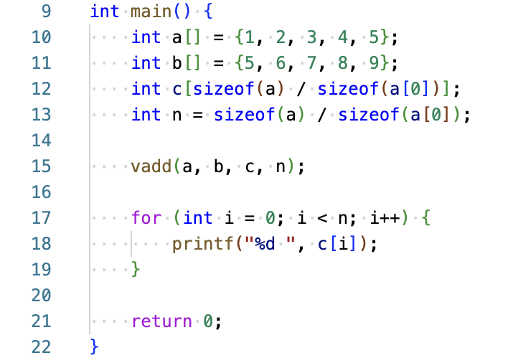
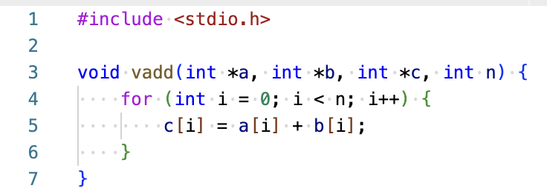
Vector add: initial SISD version

Slide 8
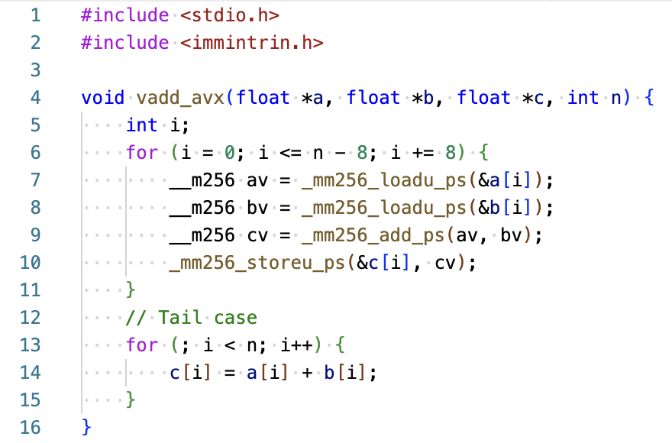
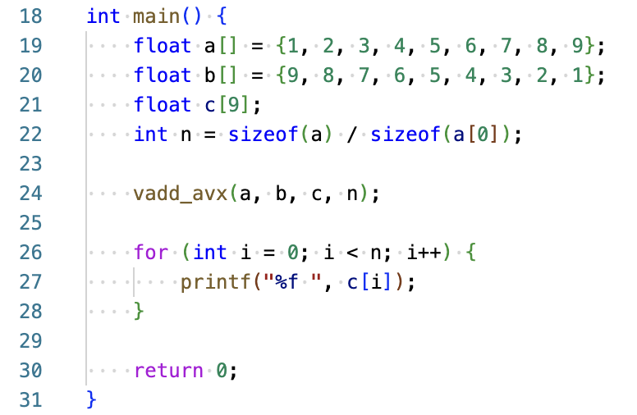
Vector add: SIMD version (x86, AVX)

Slide 9
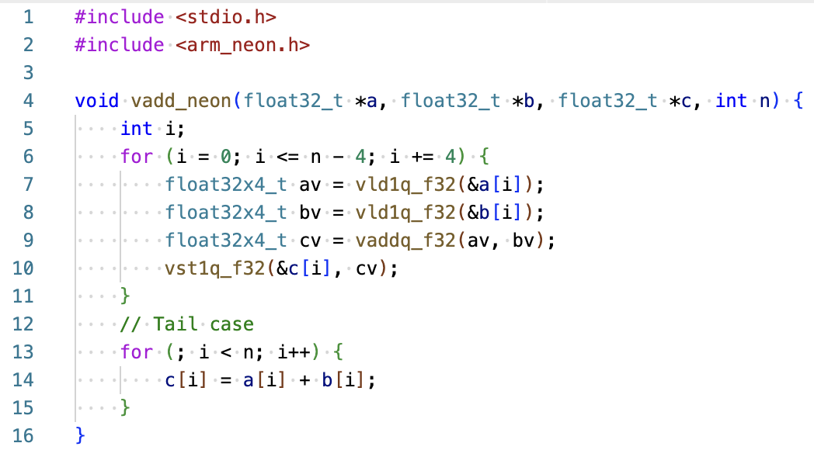
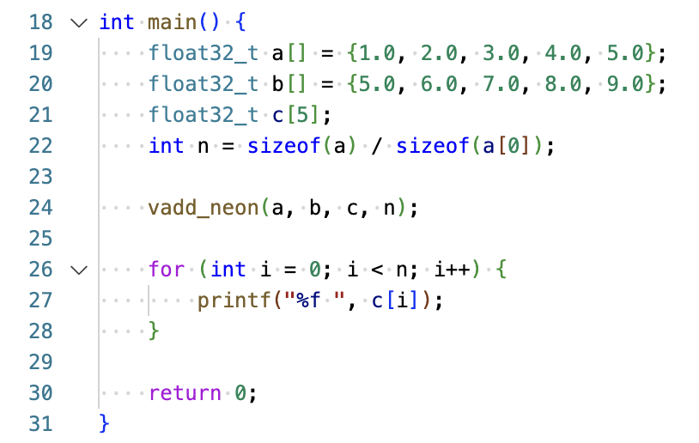
Vector add: SIMD version (ARM, NEON)

Slide 10
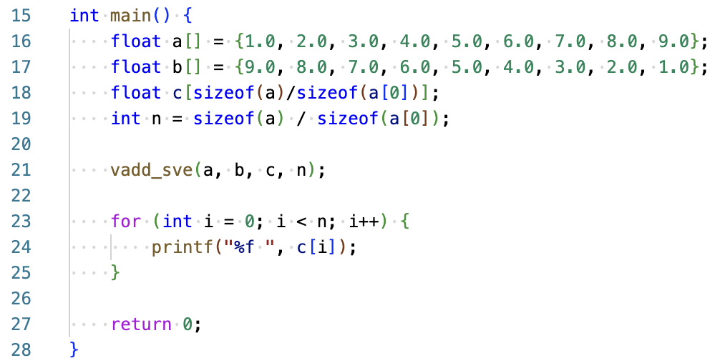
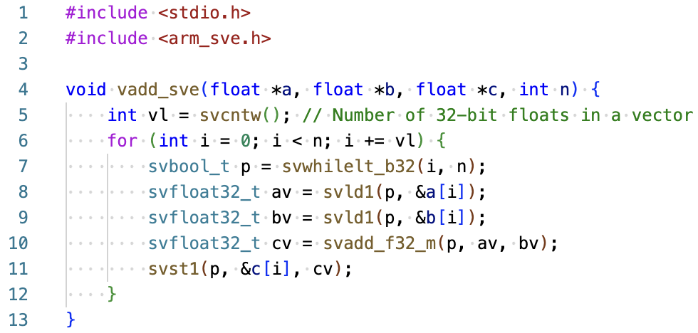
Vector add: SIMD version (ARM, SVE)

Slide 11
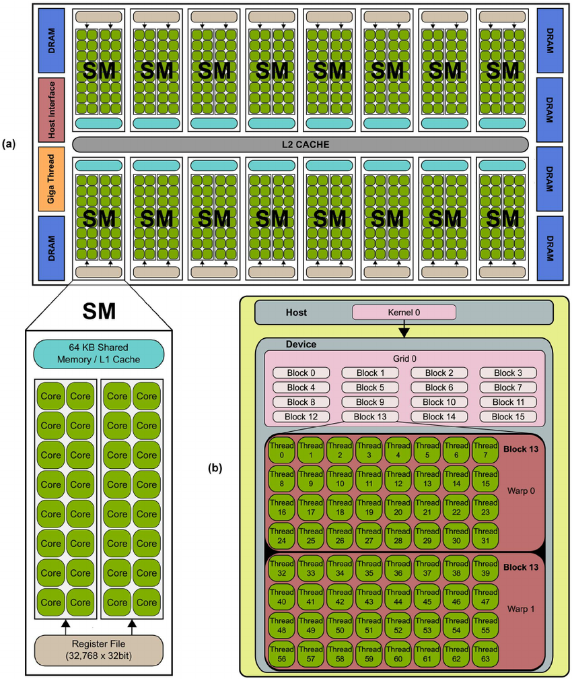
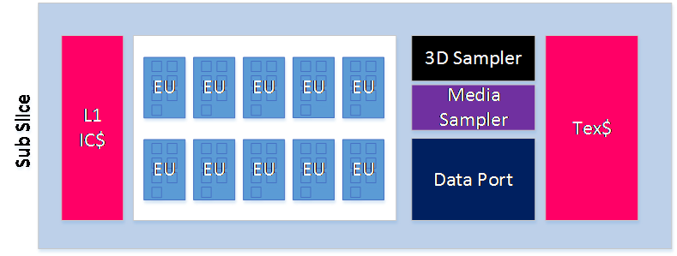
Next level: GPUs
https://www.intel.com/content/www/us/en/develop/documentation/iocl-opg/top/coding-for-the-intel-processor-graphics/execution-of-opencl-work-items-the-simd-machine.html
https://www.researchgate.net/figure/Typical-NVIDIA-GPU-architecture-The-GPU-is-comprised-of-a-set-of-Streaming_fig1_236666656

Slide 12
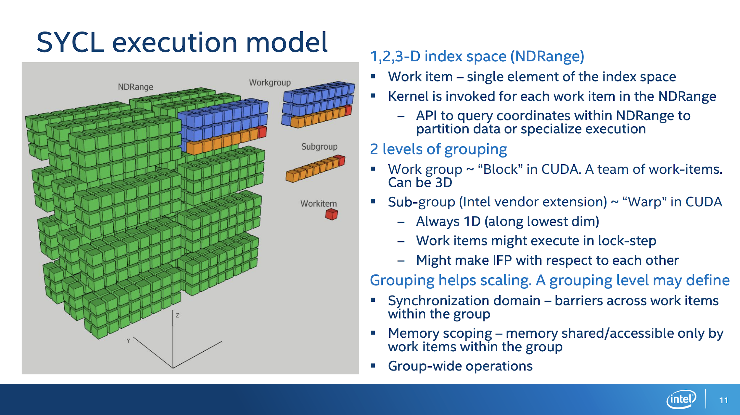
OpenCL/SYCL/CUDA/…
https://www.alcf.anl.gov/sites/default/files/2020-03/Intel_SYCL_webinar_2019_Oct_30.pdf

Slide 13
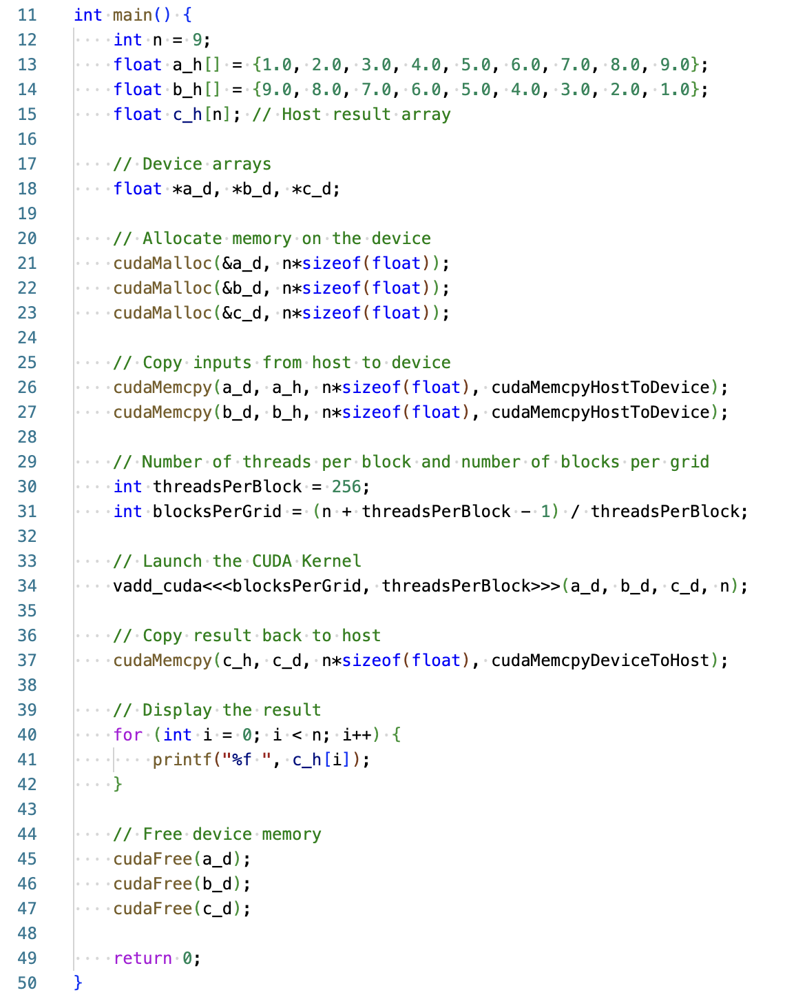
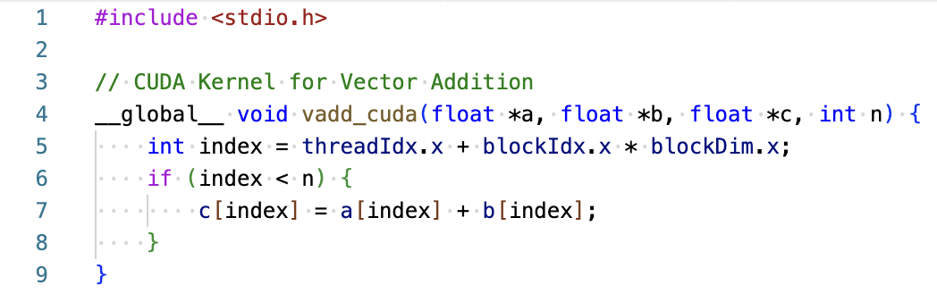
Vector add: SIMT version (NVIDIA CUDA)

Slide 14
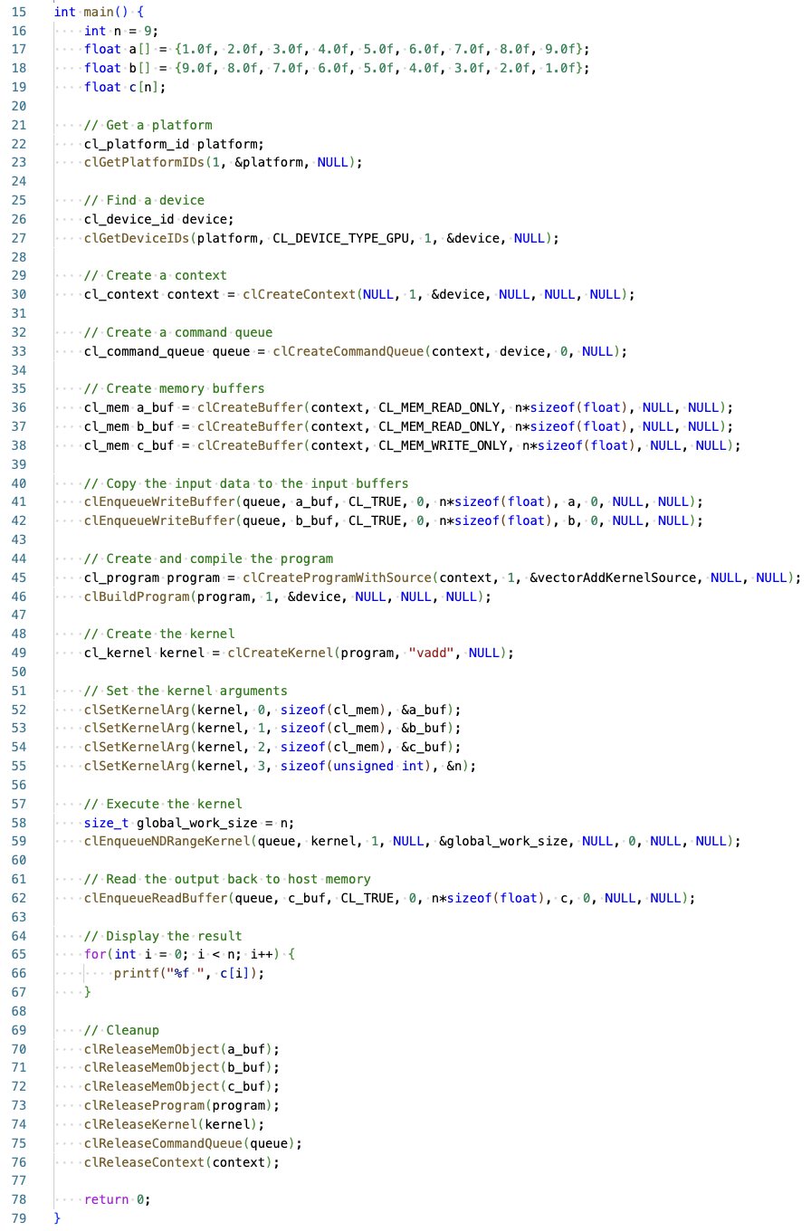
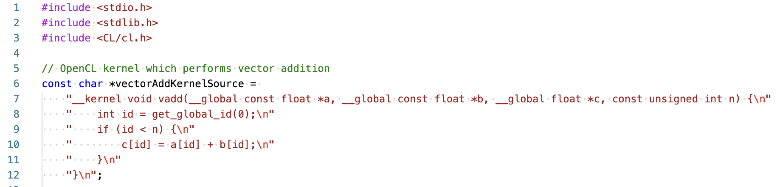
Vector add: SIMT version (OpenCL)

Slide 15
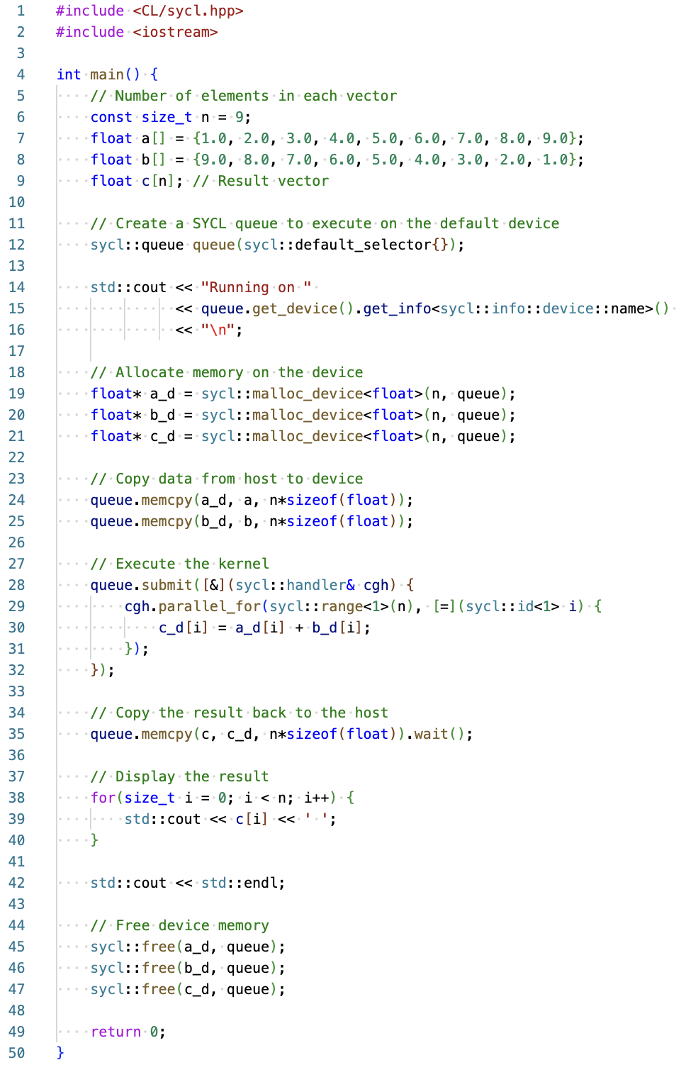
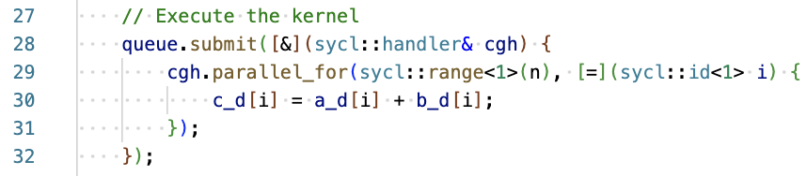
Vector add: SIMT version (SYCL)

Slide 16
SIMT vs SIMD
Different paradigms require different approach
SIMD HW: code is being vectorized by the user/compiler
SIMT HW: code is being executed in vectorized way, user specifies iteration space

Slide 17
Ways to get your code vectorized
Write in assembly
Too expensive
Use intrinsics
Good performance, poor portability
Let the compiler deal with it
Cheap, but often ineffective
Link to a library
Ultimate performance, limited algorithms

Slide 18
Vector loops
Native for many ”classic” programming models
Easy to integrate into existing programs
Not portable

Slide 19
LLVM Loop Vectorizer
Key features:
Loops with unknown trip count
Runtime check for pointers
Reductions
Inductions
If conversions
…

Slide 20
Conceptualizing loop vectorization
Think of it as loop unrolling
Unroll loop with some factor
Replace all scalar operations with vector operations
Branching is hard
Mask registers
Outer loop vectorization is hard

Slide 21
Loop dependencies
Vectorization changes the order of computation
Compiler must be able to prove that vectorization will produce correct results
Dependency analysis

Slide 22
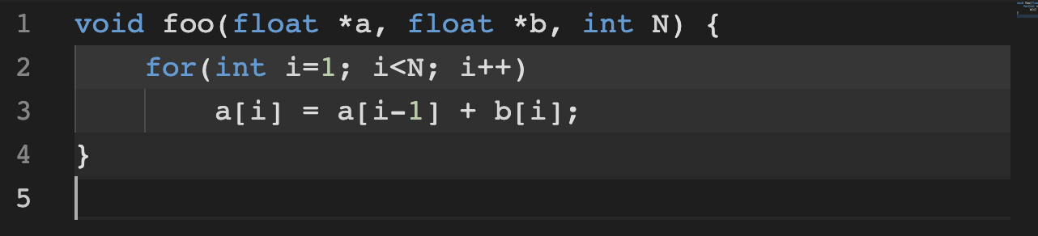
Example: read-after-write

Slide 23
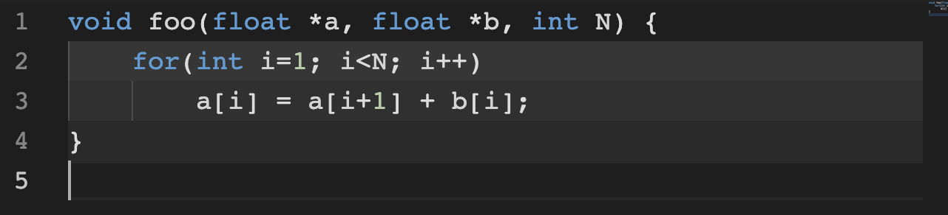
Example: write-after-read

Slide 24
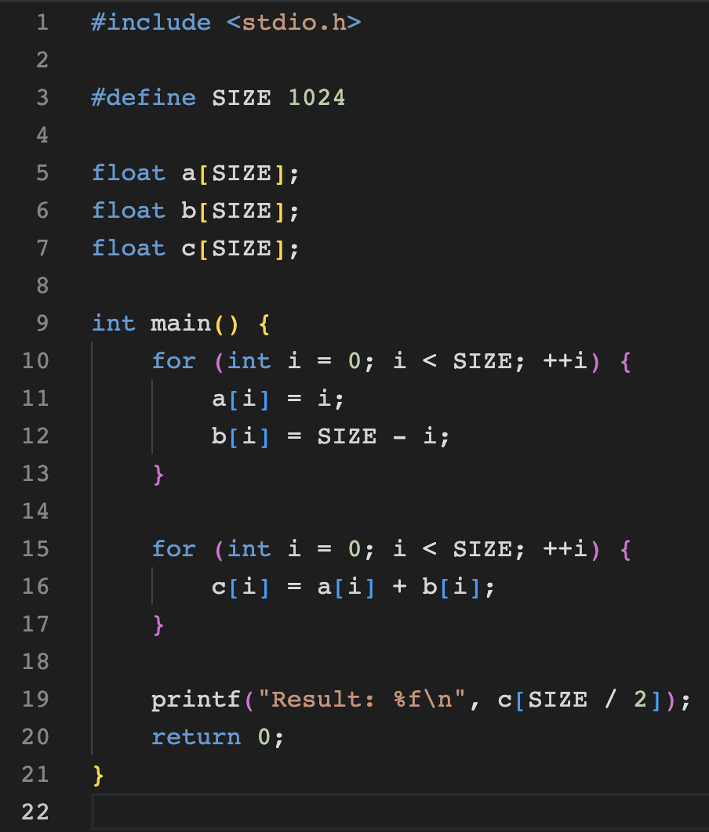
Loop vectorization demo
-fno-vectorize: https://godbolt.org/z/3vv46r8ze
default: https://godbolt.org/z/frsYGPf6v
-march=native: https://godbolt.org/z/9c76bMTos

Slide 25
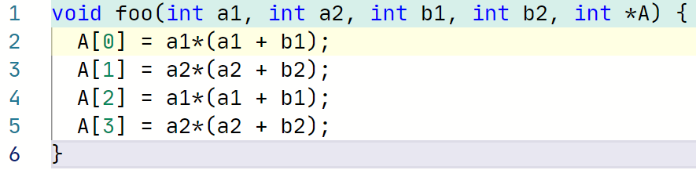
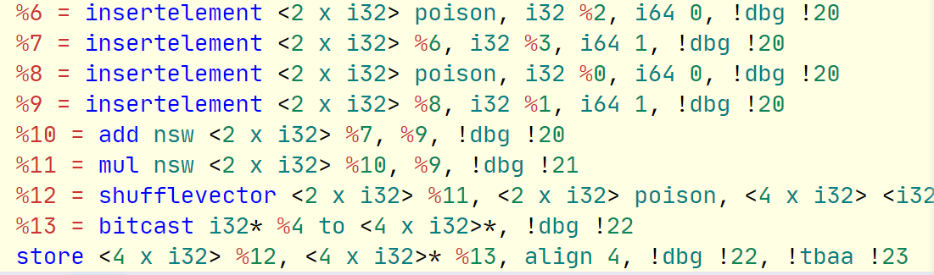
Superword-level parallelism
Aims to combine similar independent instructions into vector instructions

Slide 26
Loop Vectorization Plan
1. Legality
1. Legality
Construct
Construct
2. Planning
2. Planning
VPlans.0
VPlans.1
VPlans.N
Best VPlan.N
.1
.N
Transform
Transform
Transform
Transform
Select
Uniform
Branches
Interleave
Groups
Cost Model
Uniform
Branches
Cost Model
Interleave
Groups
Cost Model
Cost Model
Cost Model
Cost Model
Cost Model
Select
Execute
Execute
Execute
Execute
Execute
Execute
Execute
Have clear VPlans, straightforward Cost & Execute
Execute
Notes:
There’s been plenty of progress and we have new slides to share, but this one is from Gil’s presentation in EuroLLVM – the vision remained the same
Idea: model vectorization as a planning process, each VPlan is clear and self-contained, leave no sophisticated logic/ad-hoc decisions in Cost and Execute

Slide 27
Outer loop vectorization
Vectorize innermost and enclosing outer loops
Interchange outer loop to innermost position
Direct outer loop vectorization in-place
Eliminate innermost loop

Slide 28
Vectorization challenges
Data alignment
Data must fit cache lines
Aliasing
Pointers can hide data dependencies!
Vectorization cost
CPUs may drop frequencies when using vector instructions

Slide 29
Next time…
Backends
Code generation

Slide 30


Test
https://forms.gle/meM77ba76mBd2kAp7
Submission time: 10 minutes
Backup: me@gooddoog.ru

Slide 31
Extra materials
Auto-Vectorization in LLVM - https://llvm.org/docs/Vectorizers.html
F. Hahn & S. Guggilla “Outer Loop Vectorization in LLVM...” - https://www.youtube.com/watch?v=jlezxjJLQIg
S. Moll “Stories from RV: The LLVM vectorization ecosystem” - https://www.youtube.com/watch?v=BAZClv6nMxY
Outer-Loop Vectorization - Revisited for Short SIMD Architectures - https://dl.acm.org/doi/pdf/10.1145/1454115.1454119

